Slide 1

RSA Algorithm
Rivest – Shamir – Adleman

Slide 2
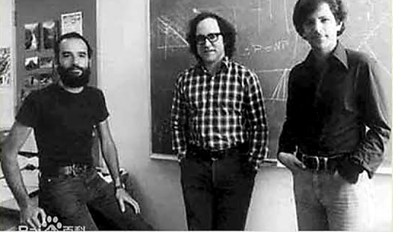
It was invented by Rivest, Shamir and Adleman in 1978 .
RSA (Rivest–Shamir–Adleman) is an algorithm used by modern computers to encrypt and decrypt messages.

Slide 3


The most secure way of encryption.

Slide 4

RSA algorithm is a public (asymmetric) key encryption technique.
Asymmetric actually means that it works on two different keys (Public Key and PrivateKey).
Decrypt
Encrypt
Public key
Private key

Slide 5


The Public Key is given to everyone and Private key is kept private.
We have public key
I have private key

Slide 6


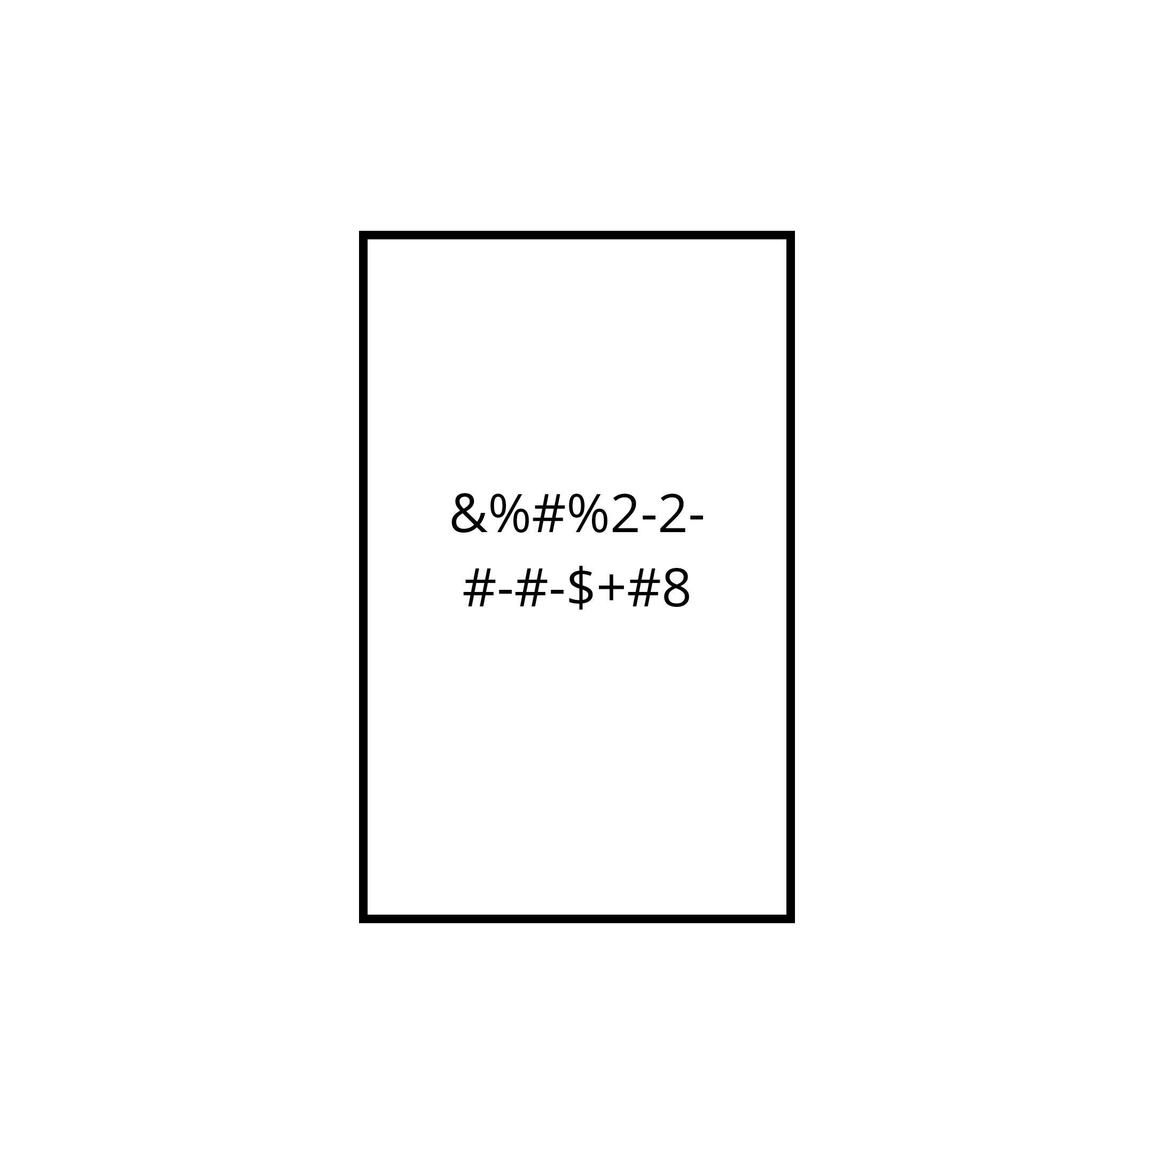
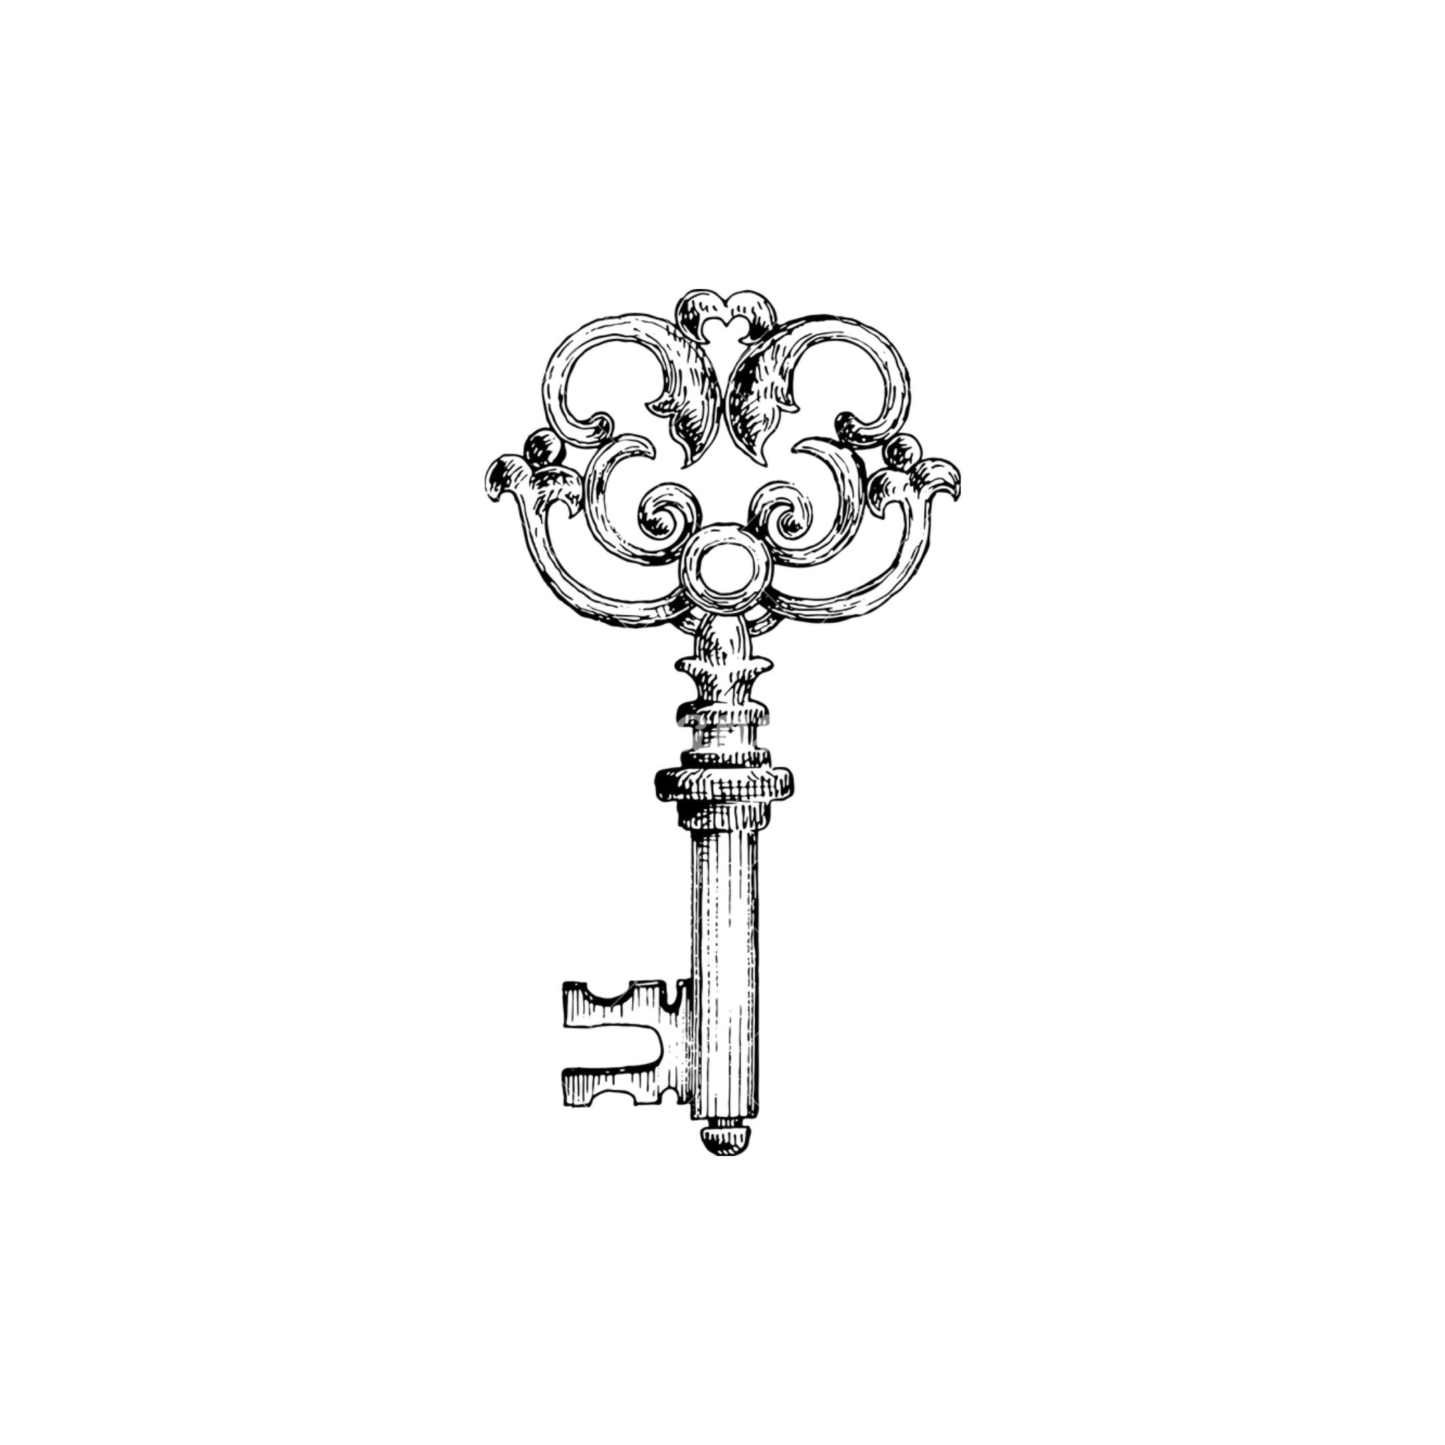
Encryption process
send
Plain text
Cipher text
Public key

Slide 7

Decryption process
receive
Cipher text
Plain text
Private key

Slide 8

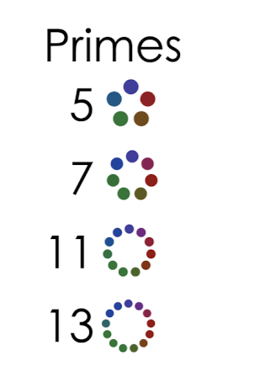

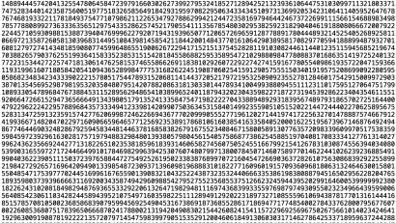

Key Generation…
Step 1
Select p and q
P and q both prime

Slide 9
Key Generation…
Step 2
Calculate n= p × q
n = p × q

Slide 10
Key Generation…
Step 3
Calculate Euler totient
(n)=(p-1)(q-1)
(n)=(p-1)(q-1)
Example :
P = 3 q = 5
N = 3 x 5 = 15
(n) = 2 x 4 = 8 (n) <n
The numbers are relatively prime to n
2,4,6,7,8,11,13,14

Slide 11
Key Generation…
Step 4
Select integer e
gcd ( (n) , e ) = 1
1 < e < Φ(n)
gcd ( (n) , e ) = 1
Example :
(n) = 2 x 4 = 8 (n) <n
e = 3 , 5 , 7
gcd(8,3) = 1
1<3<8

Slide 12


Key Generation…
Step 5
Calculate d
d = $e^{−1}$ mod (n)
d = $e^{−1}$ mod (n)

Slide 13
Key Generation…
Step 6
Pubic key {e,n}
Private key {d,n}
KU = {e,n}
KR = {d,n}

Slide 14

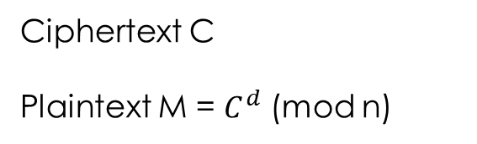
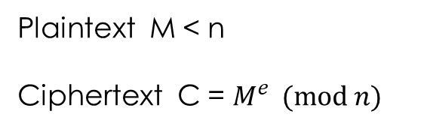
Encrypton & Decryption
Plaintext M < n
Ciphertext C = $M^{e } (mod n)$
Ciphertext C
Plaintext M = $C^{d}$ (mod n)

Slide 15
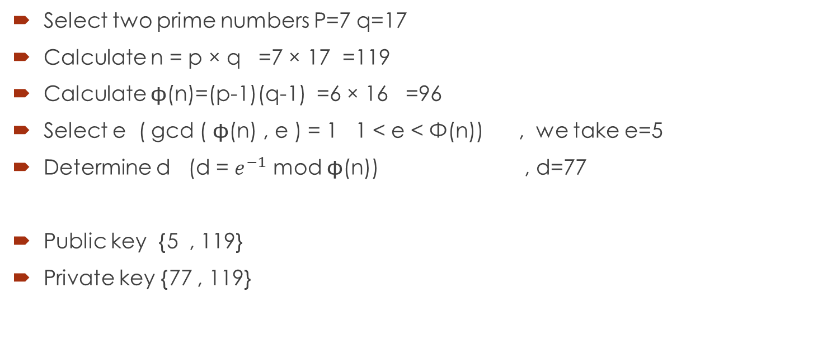
Example
Select two prime numbers P=7 q=17
Calculate n = p × q =7 × 17 =119
Calculate (n)=(p-1)(q-1) =6 × 16 =96
Select e ( gcd ( (n) , e ) = 1 1 < e < Φ(n)) , we take e=5
Determine d (d = $e^{−1}$ mod (n)) , d=77
Public key {5 , 119}
Private key {77 , 119}

Slide 16
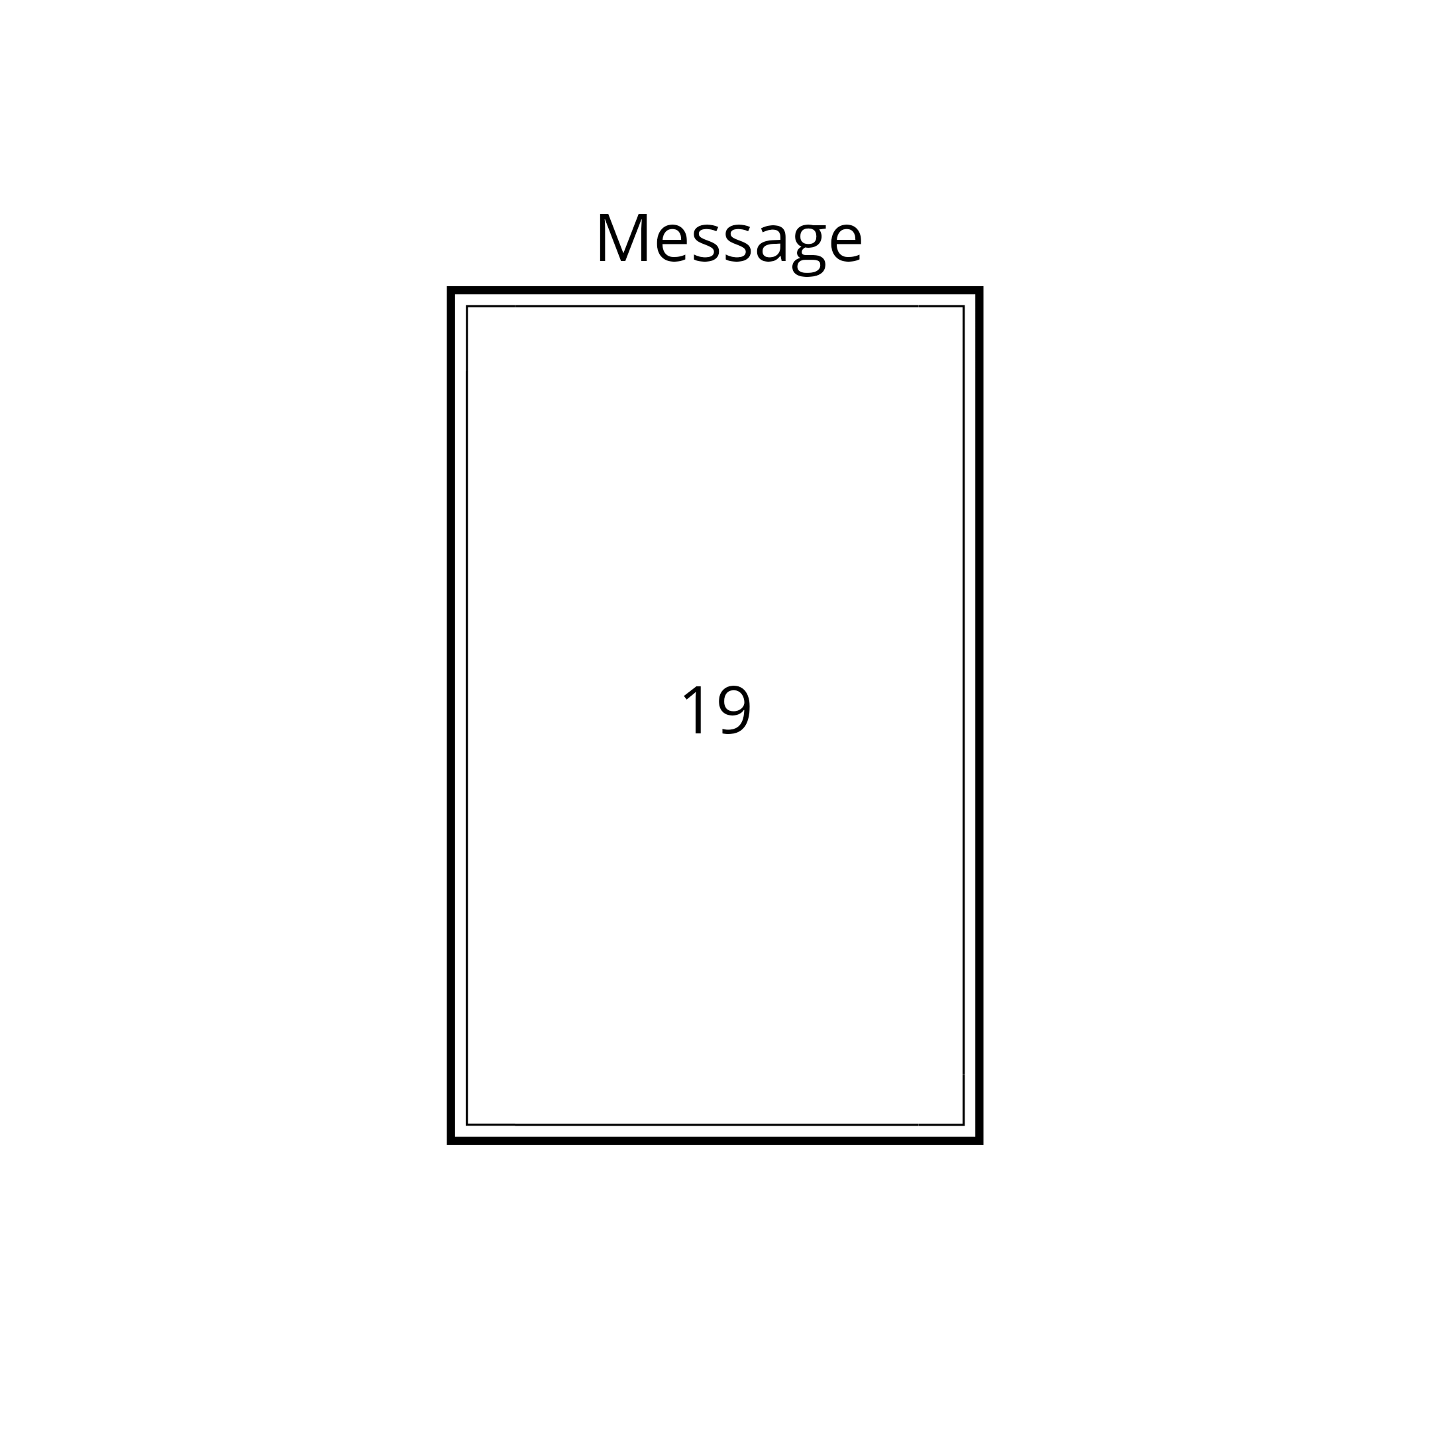
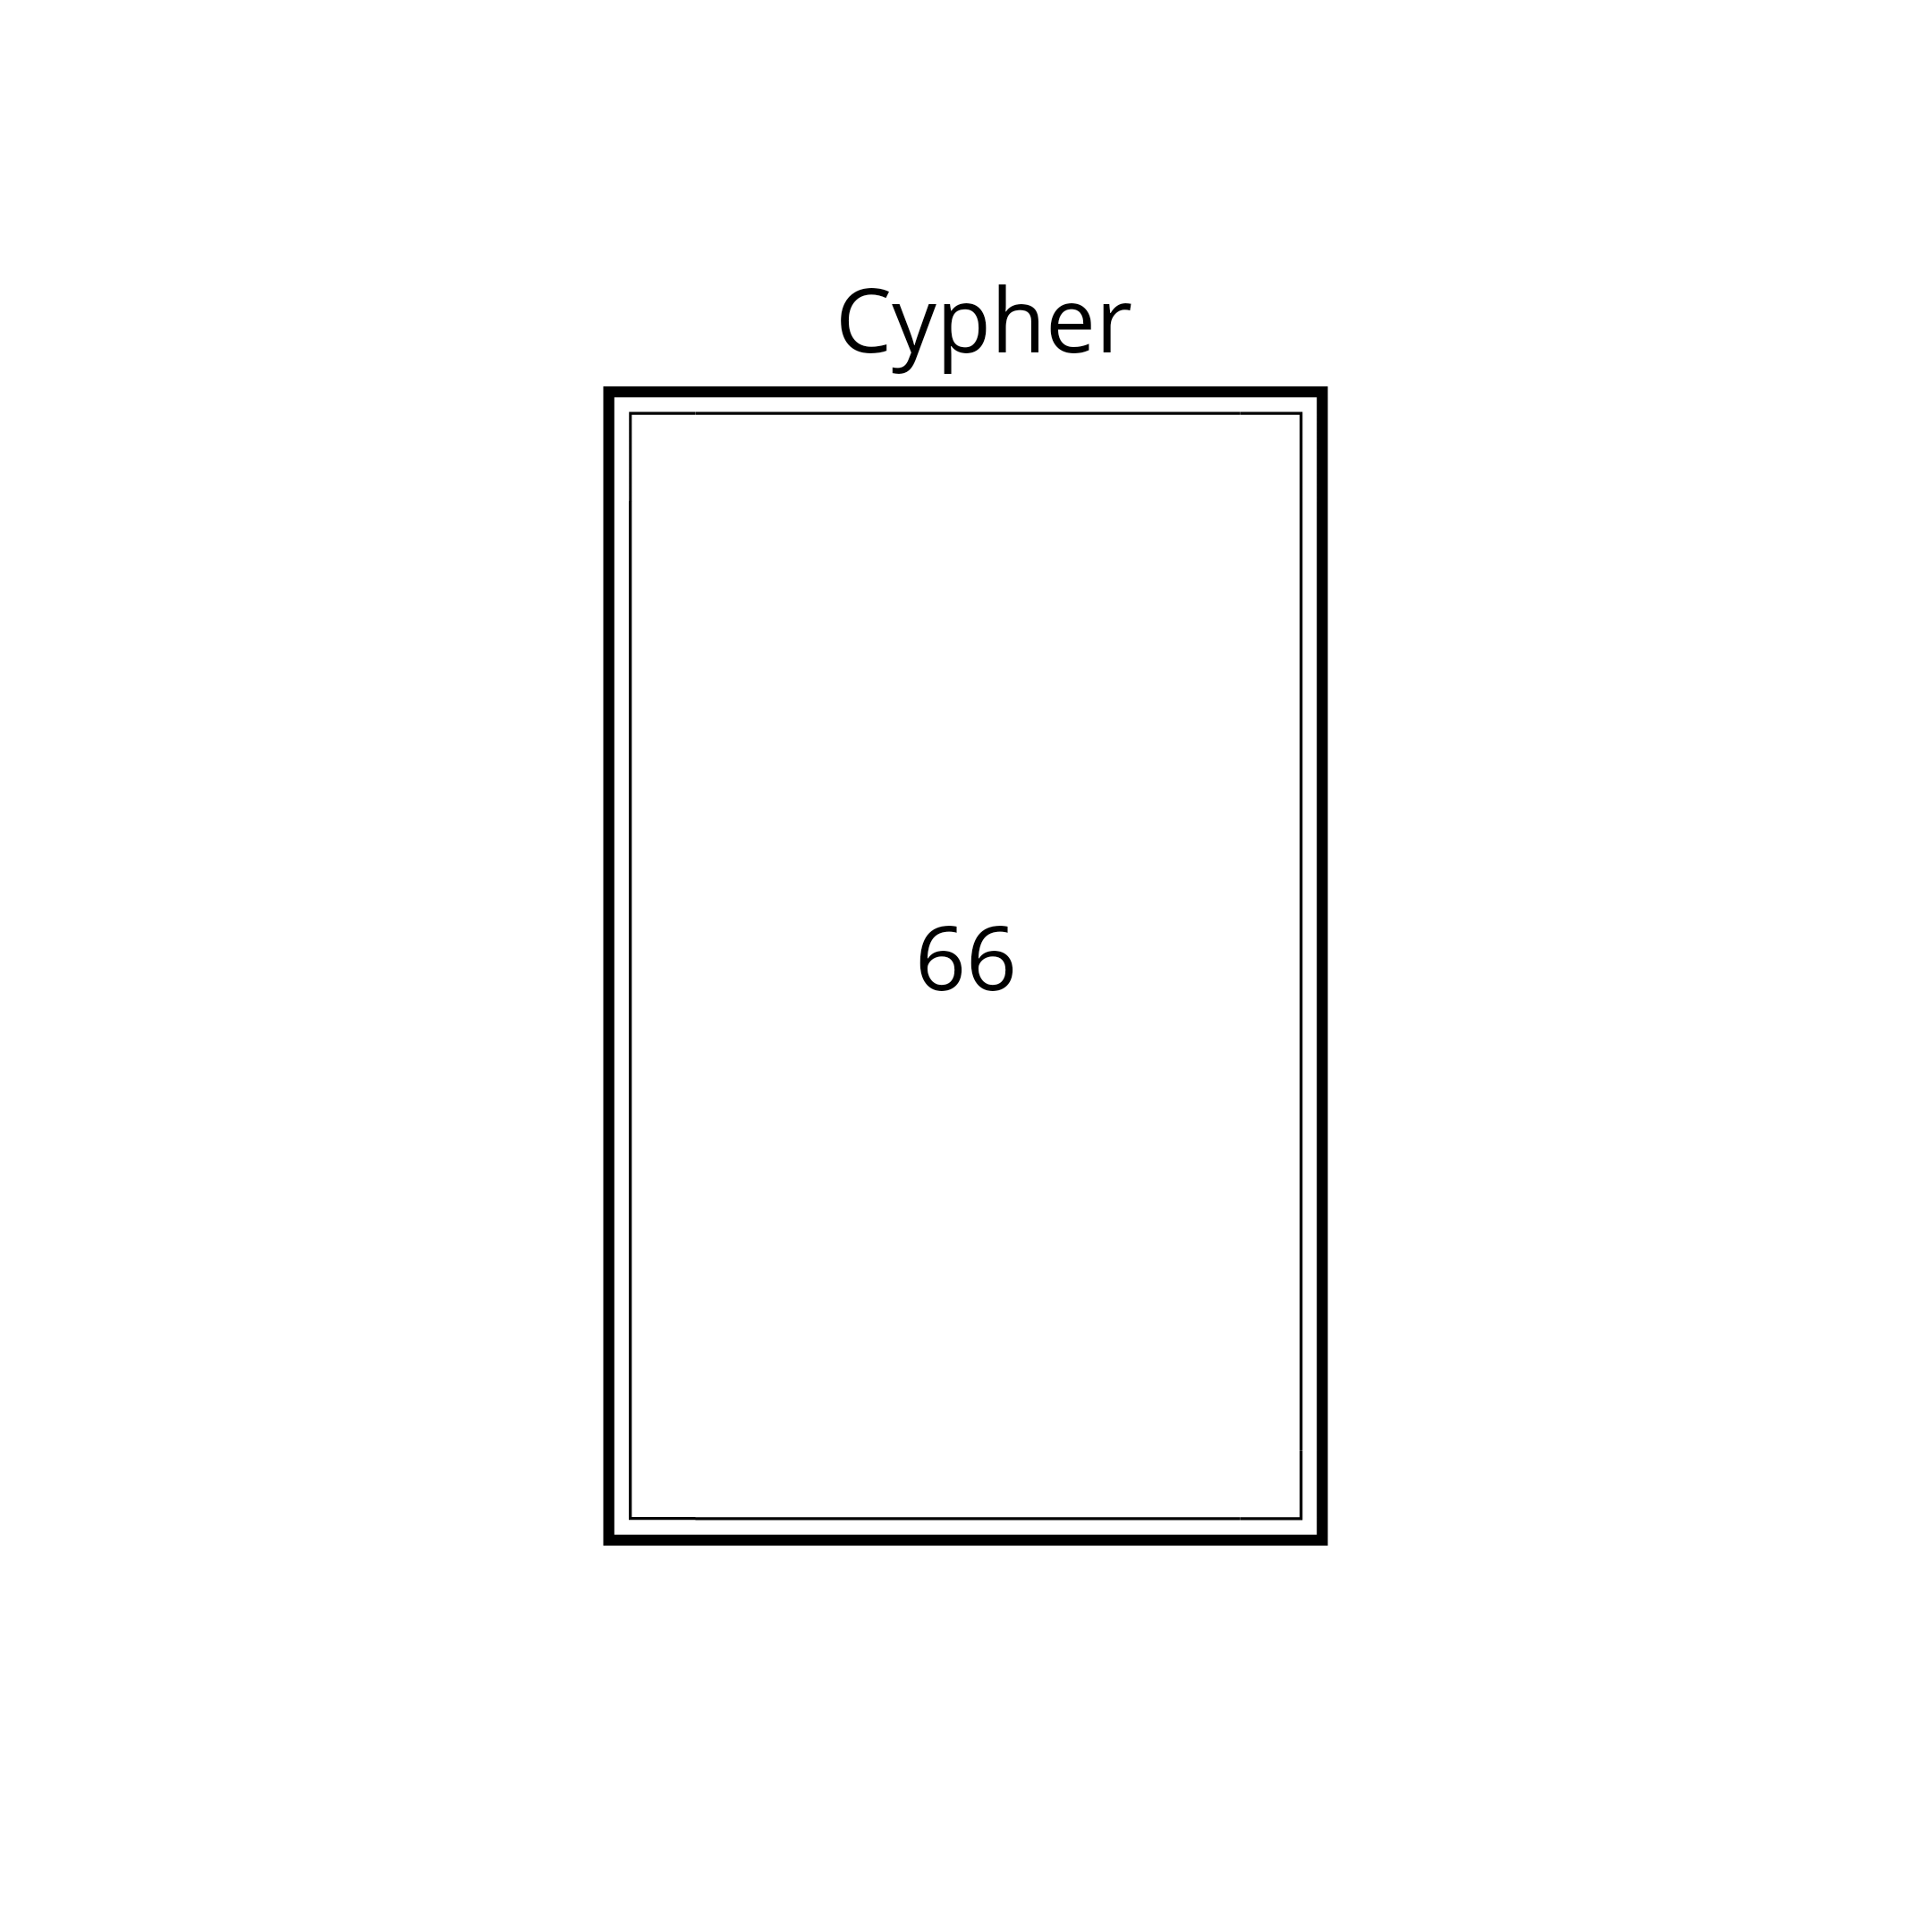


Encryption & Decryption process
Encryption
${19}^{5}$(mod 119)
Decryption
${66}^{77}$(mod 119)

Slide 17
The security
RSA is secure since
We use large number of bits e and d
The problem of factoring n into two prime factors is computationally very difficult.
Knowing p and q will allow us to know Euler totient
This will help an intruder to know the values of e and d
Key size in the range 0f 1024 and 2048 bits seems safe

Slide 18
use
The RSA algorithm in conjuction with some private key algorithm (like AES ) can be used for secure data transfer over insecure channel
The private key encrypted use RSA
K is used for private key encryption

Slide 19
Thank you …

